Slide 1
Compare Register 1 Value (CCR1) = 500, Auto-Reload Register (ARR) Value = 1000
Count Value
Count value == Compare Register Value, Interrupt occurs!
ARR Value reached for counter; Count value resets and interrupt occurs!
1000
999
998
…
501
500
499
498
…
4
3
2
1
0
…
…
Clock Cycles
1 2 3 4 … 498 499 500 501 … 998 999 1000 0 1 2 3 4

Slide 2
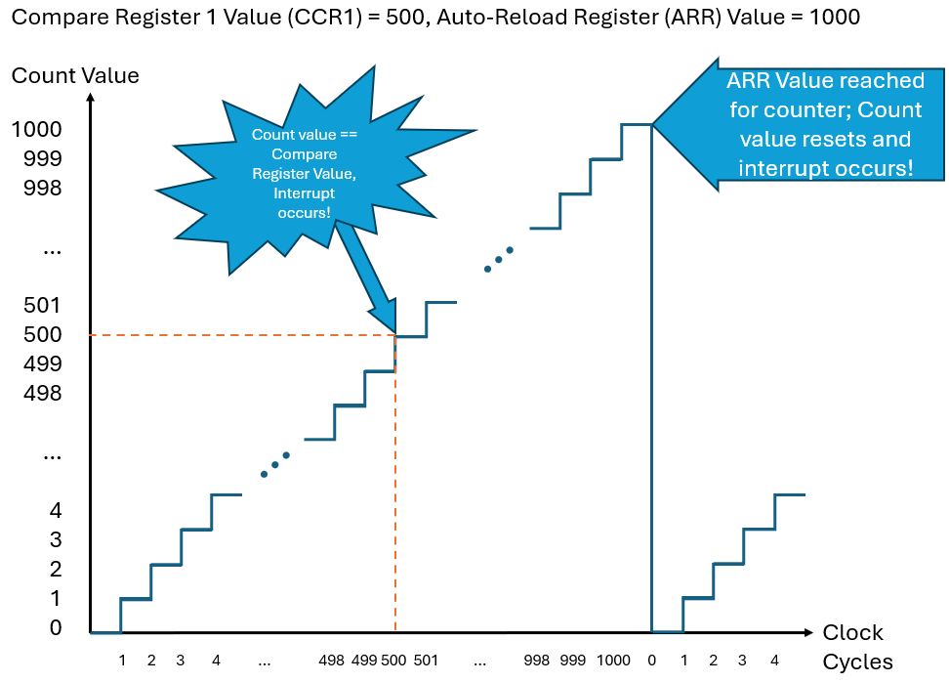
Voltage on GPIO Output:

